Slide 1

Capstone Project - Spotify Song Recommender
Team 3 - Arseny Yuzhakov, David He, Griffin Williams, Jaewan Lim and Joaquin Trujillo

Slide 2

Brief overview of the original model
Spotify Song Recommender Engine
Explores the data using heatmap & histograms
Analyzes using k-means
Analyzes and recommends songs closest to a user’s favorite songs
Weaknesses:
Does not take user feedback into account
Does not have a smooth user-interface
Takes a single clustering technique into account

Slide 3

The enhancements made and their benefits
Asked a user’s favorite song, how good they feel today on a scale of 1-5, their current situation, etc.
Set a mood range based on user input
Ask the user for current situation (music to sing along to, with family, etc.)
Filter data based on situational information
Analyze and recommend songs
Benefits
Data can be reduced much more
Songs that fit for wherever the user is make a perfect recommendation
Match a user’s feeling so that songs can make their day better

Slide 4
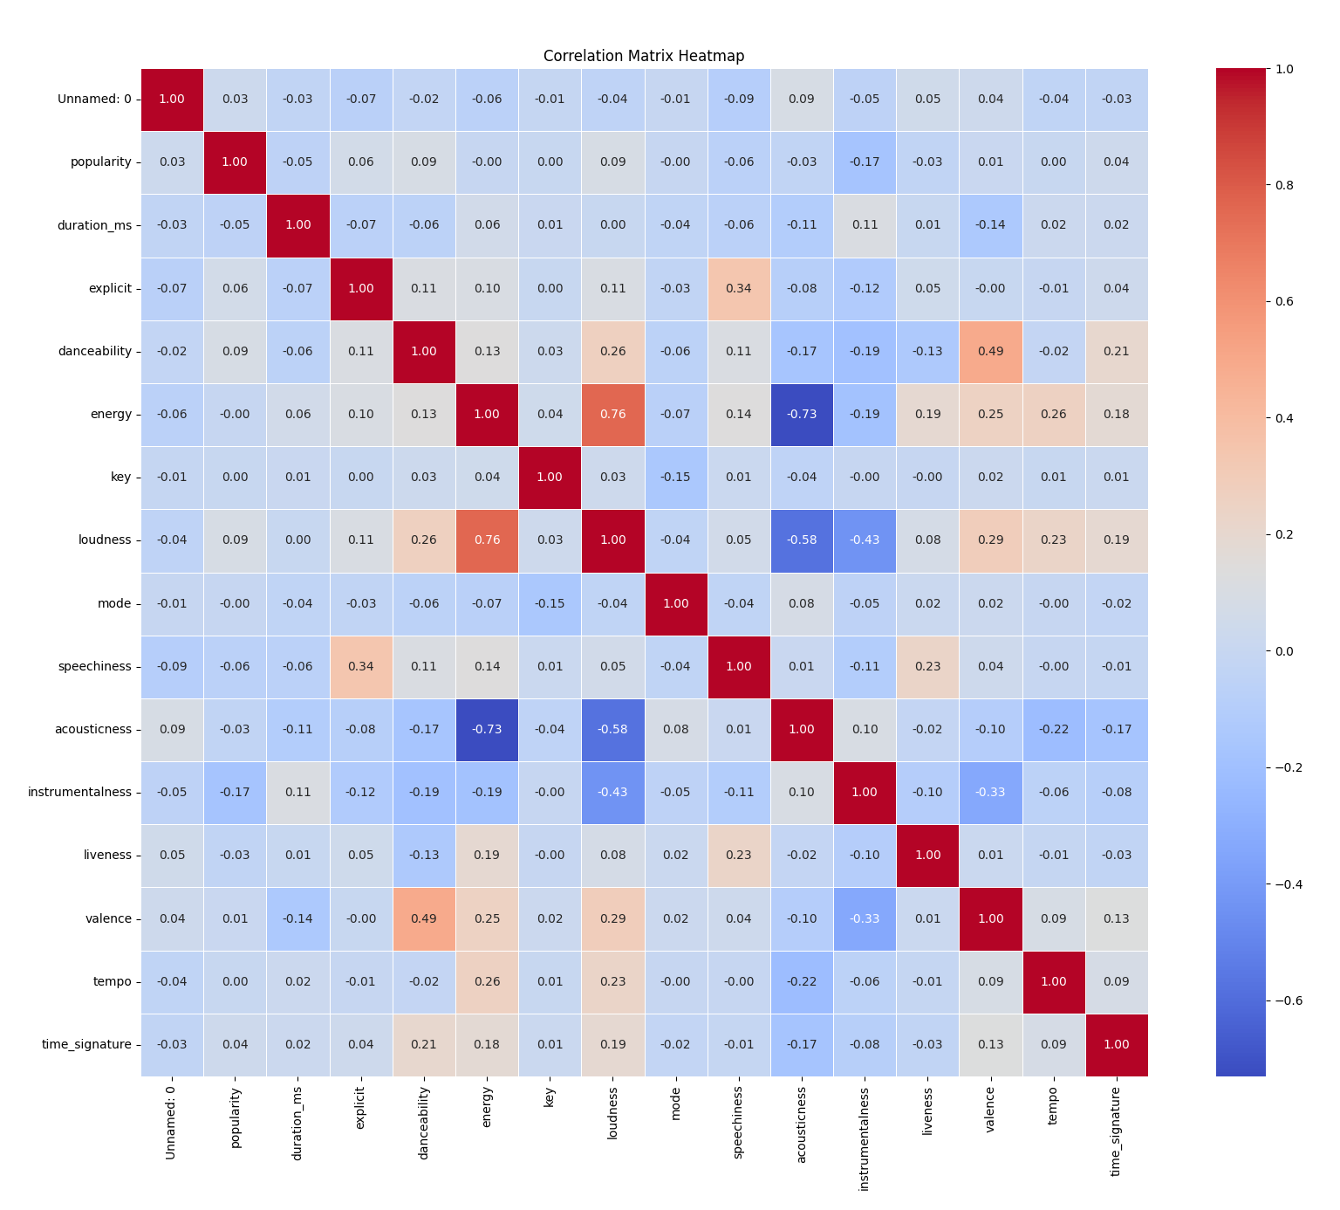
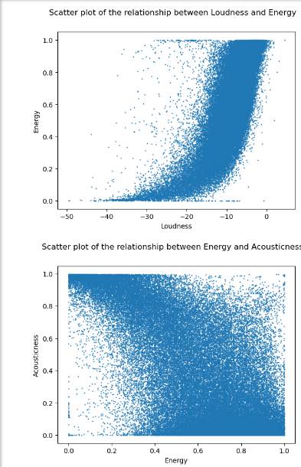
Findings from the data exploration part
Original data contained duplicates → removed to reduce the data
Strong relationship between variables
Ex. Loudness & Energy, Energy & Acousticness
Used scatter plot & heatmap to visualize it

Slide 5
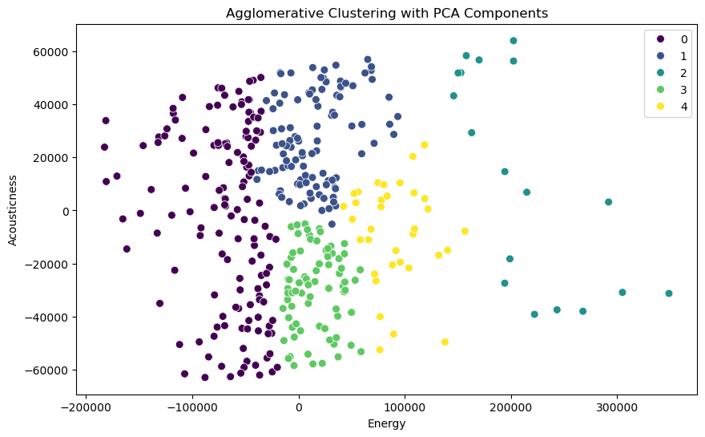
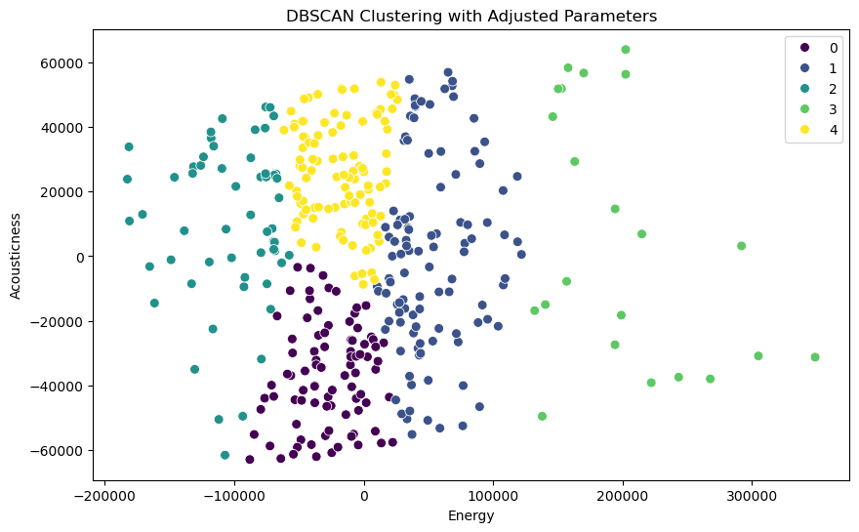
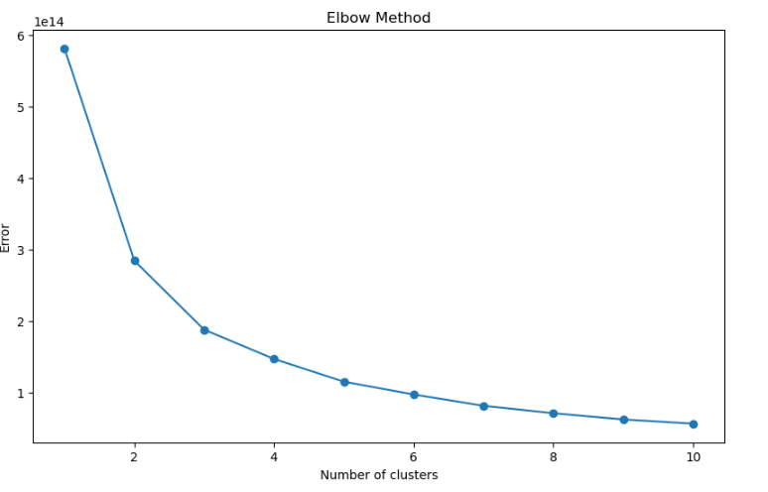
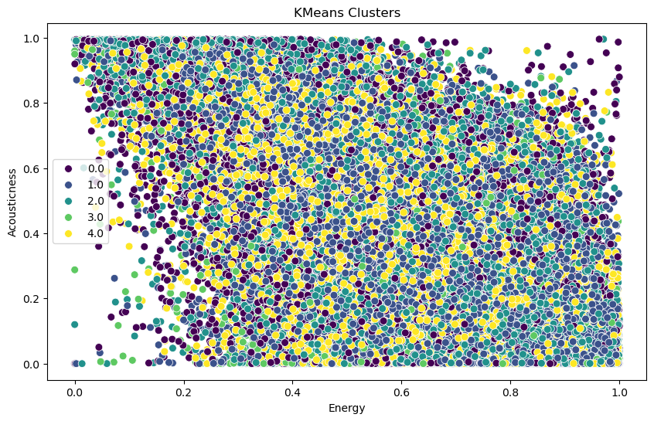
Comparison of different clustering algorithms used
Clustering Algorithms:
The Elbow Method revealed that the optimal number of clusters were 4-5.
There is a significant distinction between clusters in the plot.
They have been properly distributed across the space, formed by two components: Acousticness and Energy.
Each cluster represent a different type of music based on these features.
Notes:
DBSCAN does not require you to input the number of clusters. But performance is still based on parameters ( epsilon and min points) and struggles with larger datasets
Agglomerative clustering starts with each point as a cluster and merges neighboring clusters until the # of clusters is met which can be very ineffective for larger datasets.
Plots the within-cluster sum of squares (inertia) against the number of clusters. The "elbow" point, where the rate of decrease sharply slows, indicates the optimal number of clusters.
Aggolometive uses hierarchical clustering which puts points into clusters based on their distance
DBSCAN organize clusters based on density of points

Slide 6


Incorporation of user feedback into the model in future and its impact
Feedback
Asked the user if they liked the recommendations.
If not, recommend different songs based on the user’s favorite cluster.
Feedback Incorporation
Feedback is added to the dataset.
Collect more information about user’s interaction with the recommended songs and add it to the dataset (skips, replays, etc).
The model is re-trained with the new user ratings and user interaction to update its recommendations.
Impact
Recommendations become more precise and accurate according to the user’s preferences.
Better model adaptability.
Higher user satisfaction.

Slide 7

Other future enhancements that were made to the model
Add more helpful/useful features
Allow users to give feedback on their song recommendations. If the feedback is negative, our model will revise and present new song suggestions.
No lagging when running
Reduce the data into a smaller number based on a user’s favorite songs
More accurate data, and easier to visualize clustering graphs (ours had too many points; hard to visualize)
Use more algorithms to get a more accurate clusters

Slide 8

THANKS FOR LISTENING!

